Slide 1
Forest Dinner Party

Slide 2
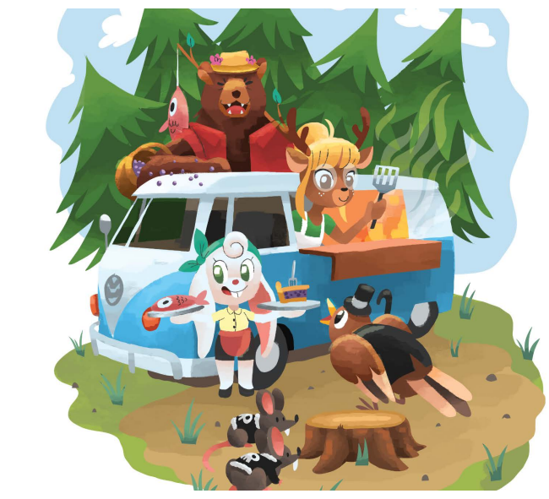
You are managing a food truck in the forest.
You need to forage for food and cook for the animals that live here.

Slide 3
Forest Dinner Party
Tutorial

Slide 4
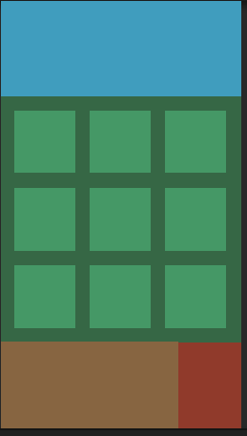
Board
This is where the tiles will generate.
Hand
This is where your cards will be.

Slide 5
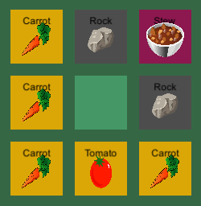




Tiles
Tiles are the items on the board which you manipulate. Different types of tiles have different purposes
Food
Obstacles
Meals
NB: All images are placeholder

Slide 6
Food
The most common type of tile
Each is a single ingredient with some attached points
Are used to make meals
Yellow Colour

Slide 7
Obstacles
Needed as a base to cook meals
Can’t be used as an ingredient
Grey Colour

Slide 8
Meals
Not naturally generated
Made by playing cards which combine tiles
Can be fed to the customer to get points
Dark purple Colour

Slide 9

Cards
Cards are the actions that you have available to you from your hand. Different types of cards have different effects.
NB: More cards are being designed

Slide 10
Cooking
When used on an obstacle tile, will create a meal
The directional arrows on the card indicate which adjacent food tiles will be used in the meal
If those tiles do not contain food, they will be ignored, and won’t give points
Light purple colour

Slide 11
Explosives
When used on a tile will destroy it, removing it from the game entirely
Red Colour
NB: This card will be reflavoured

Slide 12

Discarding
You can discard cards rather than using them
This gives you the ability to move one tile to an empty space on the board
NB: This card will be reflavoured

Slide 13

Customers
Meals can be given to the customer at the top of the screen
Once delivered, you will receive points based on the quality of the meal
NB: There is currently only one customer

